Slide 1

DOUBLE LINKED LISTS

Slide 2
The following are problems with singly
linked lists:
A singly linked list allows traversal of the
list in only one direction.
2) Deleting a node from a list requires
keeping track of the previous node, that is,
the node whose link points to the node to be
deleted.
3) If the link in any node gets corrupted, the
remaining nodes of the list become
unusable.

Slide 3
These problems of singly linked lists can be
overcome by adding one more link to each
node, which points to the previous node. When
such a link is added to every node of a list, the
corresponding linked list is called a Doubly
linked list.
Double Linked List is defined as a collection of
elements, where each element consisting of 3
fields:
A Pointer to left element (left link)
Data field and
A Pointer to right element (right link)

Slide 4
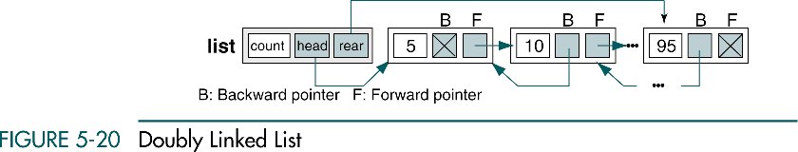

Slide 5
Algorithm for creating a Double Linked List
Algorithm Createdl(dlist * start)
{
Define a structure LIST with fields
DATA, Left pointer, Right pointer.
struct dl_list
{
int data;
struct dl_list * right;
struct dl_list * left;
};

Slide 6
typedef struct
{
int count;
dl_list * head ;
} LIST;
2) Declare a pointer by name list and by
using malloc() memory allocation function
allocate space for one element and store
the address in head pointer.
LIST * list;
list = (LIST *)malloc(sizeof(LIST));

Slide 7
3) Read the value for list → data,
list → left and list →right.
If (list)
{
list → head = NULL;
list → head→ left = NULL;
list → head→ right = NULL;
list → count = 0;
}
return list;
}

Slide 8
INSERTING AN ELEMENT INTO A DOUBLE LINKED LIST
Inserting an element into a Double linked list
involves 4 cases.
Insert into empty list
Insert at beginning
Insert in middle
Insert at end

Slide 9
Insert into empty list
To insert a node into a empty list, we simply
need to set the header’s forward pointer to the
new node and set the new node’s backward
pointer to the header node.
The forward pointer of the new node is set to
null, indicating the end of the list.
If a rear pointer is being used, it also needs to
be set to the new last node.
if (pPre → forw = null)
{
pNew → forw -> link = plist → head
plist → head = pNew
pNew → back →link = head
}

Slide 10
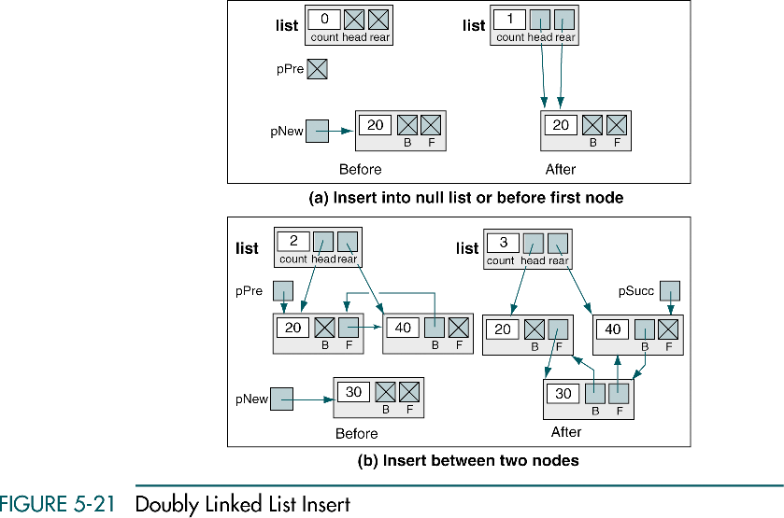

Slide 11
INSERTING AT THE BEGINNING
OR
INSERTING BEFORE THE FIRST NODE
To insert a node at the beginning of the
list the new node needs to be set to point
to both its predecessor and its successor.
The predecessor is the header node.

Slide 12
Insert in middle
To insert a node at the middle of the list set the
new node’s forward pointer to point to the
predecessor’s forward pointer and then set the
new node’s backward pointer to point to the
predecessor.
pNew → back = pPre
pNew → forw = pPre ->forw
pPre → forw = pNew
pSucc →back = pNew

Slide 13
Insert at end
When inserting a node as the last node in the list the predecessor of the new node needs to be set to point to the new node and new node’s backward pointer needs to be set to point back to the predecessor.
The forward pointer of the new node needs to be set to null.
Finally the rear pointer needs to be set to point to the new end of the list.
if (pPre → forw = null)
{
pList → rear = pNew
}

Slide 14
Algorithm insertdbl(LIST *pList , void *dataInptr)
If (full list)
{
return false
}
2) Locate insertion position in the list
found = searchList(pList, pPre, pSucc, dataIn.key)
3) if (found == false)
Allocate (pNew)
pNew → dataPtr = dataIn
pNew → back = pPre
pNew → forw = pPre -> forw
pPre → forw = pNew
pSucc →back = pNew

Slide 15
4) Test for insert into null list or at end of list
if (pPre →forw = null)
{
pNew → forw → link = plist →head
plist → head = pNew
pNew → back →link = head
// Inserting at the end of the list
plist → rear = pNew
else

Slide 16
5) Inserting in the middle of the list
pPre → forw = pNew
pList → count = (pList → count)++;
return true
}
Deleting a node from a Double Linked List
Deleting a node from a Doubly linked list
requires that the deleted node’s predecessor
be pointed to the deleted node’s successor,
if any, and that the successor be pointed to
by the Predecessor.
Once the node to be deleted has been
located, we simply change its predecessor’s
and successor’s pointers and recycle the
node.

Slide 17
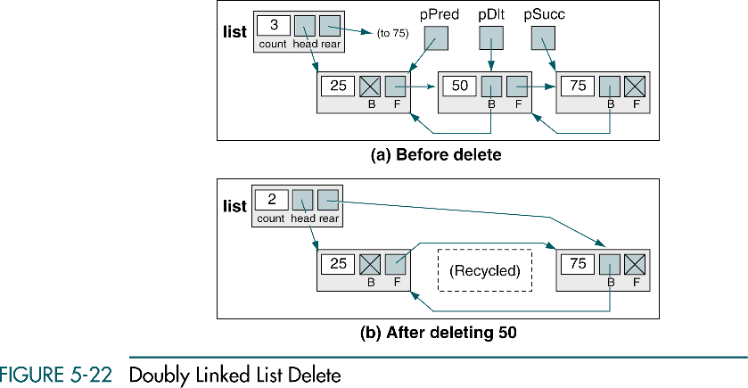

Slide 18
Algorithm deleteDbl(LIST *plist , NODE *
pLoc, void *dataoutptr)
dataoutptr → pLoc →dataPtr;
Deleting first node from the list
if (pPre == null)
{
pList → head = pLoc →link;
pLoc → forw → link = head;
pLoc → back → link = head;
free (pLoc)
else

Slide 19
2) Deleting a node any other node from the list
pPre →link = pLoc → link
pPre = pLoc → back
pSucc = PLoc → forw
pPre → forw = pSucc
else
3) Test for deleting the last node
if (pSucc == null)
{
pPre → forw = pSucc
Free(pLoc);
(pList → count) -- ;
return
}

